Slide 1



Response bias
Dr. Felipe Valentini
Dr. Ricardo Primi

Slide 2


Slide 3
Felipe Valentini
Professor at the Graduate School of Psychology, University São Francisco, Brazil
Chair of the International Test Commission (ITC) Outreach Committee
Ricardo Primi
Professor at the Graduate School of Psychology, University São Francisco, Brazil
Council member EduLab21, Ayrton Senna Institute
Psychometrics (response bias, heterogeneity, test construction)
Intelligence, Personality, Achievement and Professional Interests

Slide 4
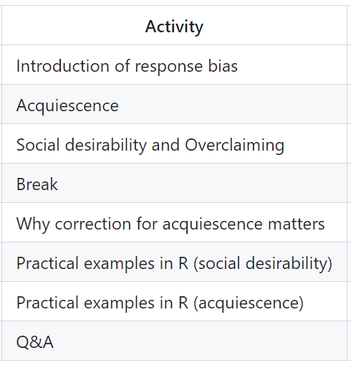
We are assuming a heterogeneous group
We will cover
Basic topics
Recent and advanced discussions
github.com/rprimi/itc_response_bias_workshop

Slide 5
Likert Item...
Strongly disagree
Disagree
Neutral
Agree
Strongly agree
Self Report
We assume that it is an intuitive way to describe some characteristic.
We assume that participants understand the scale.
We assume that all participants understand the scale in the same way.

Slide 6
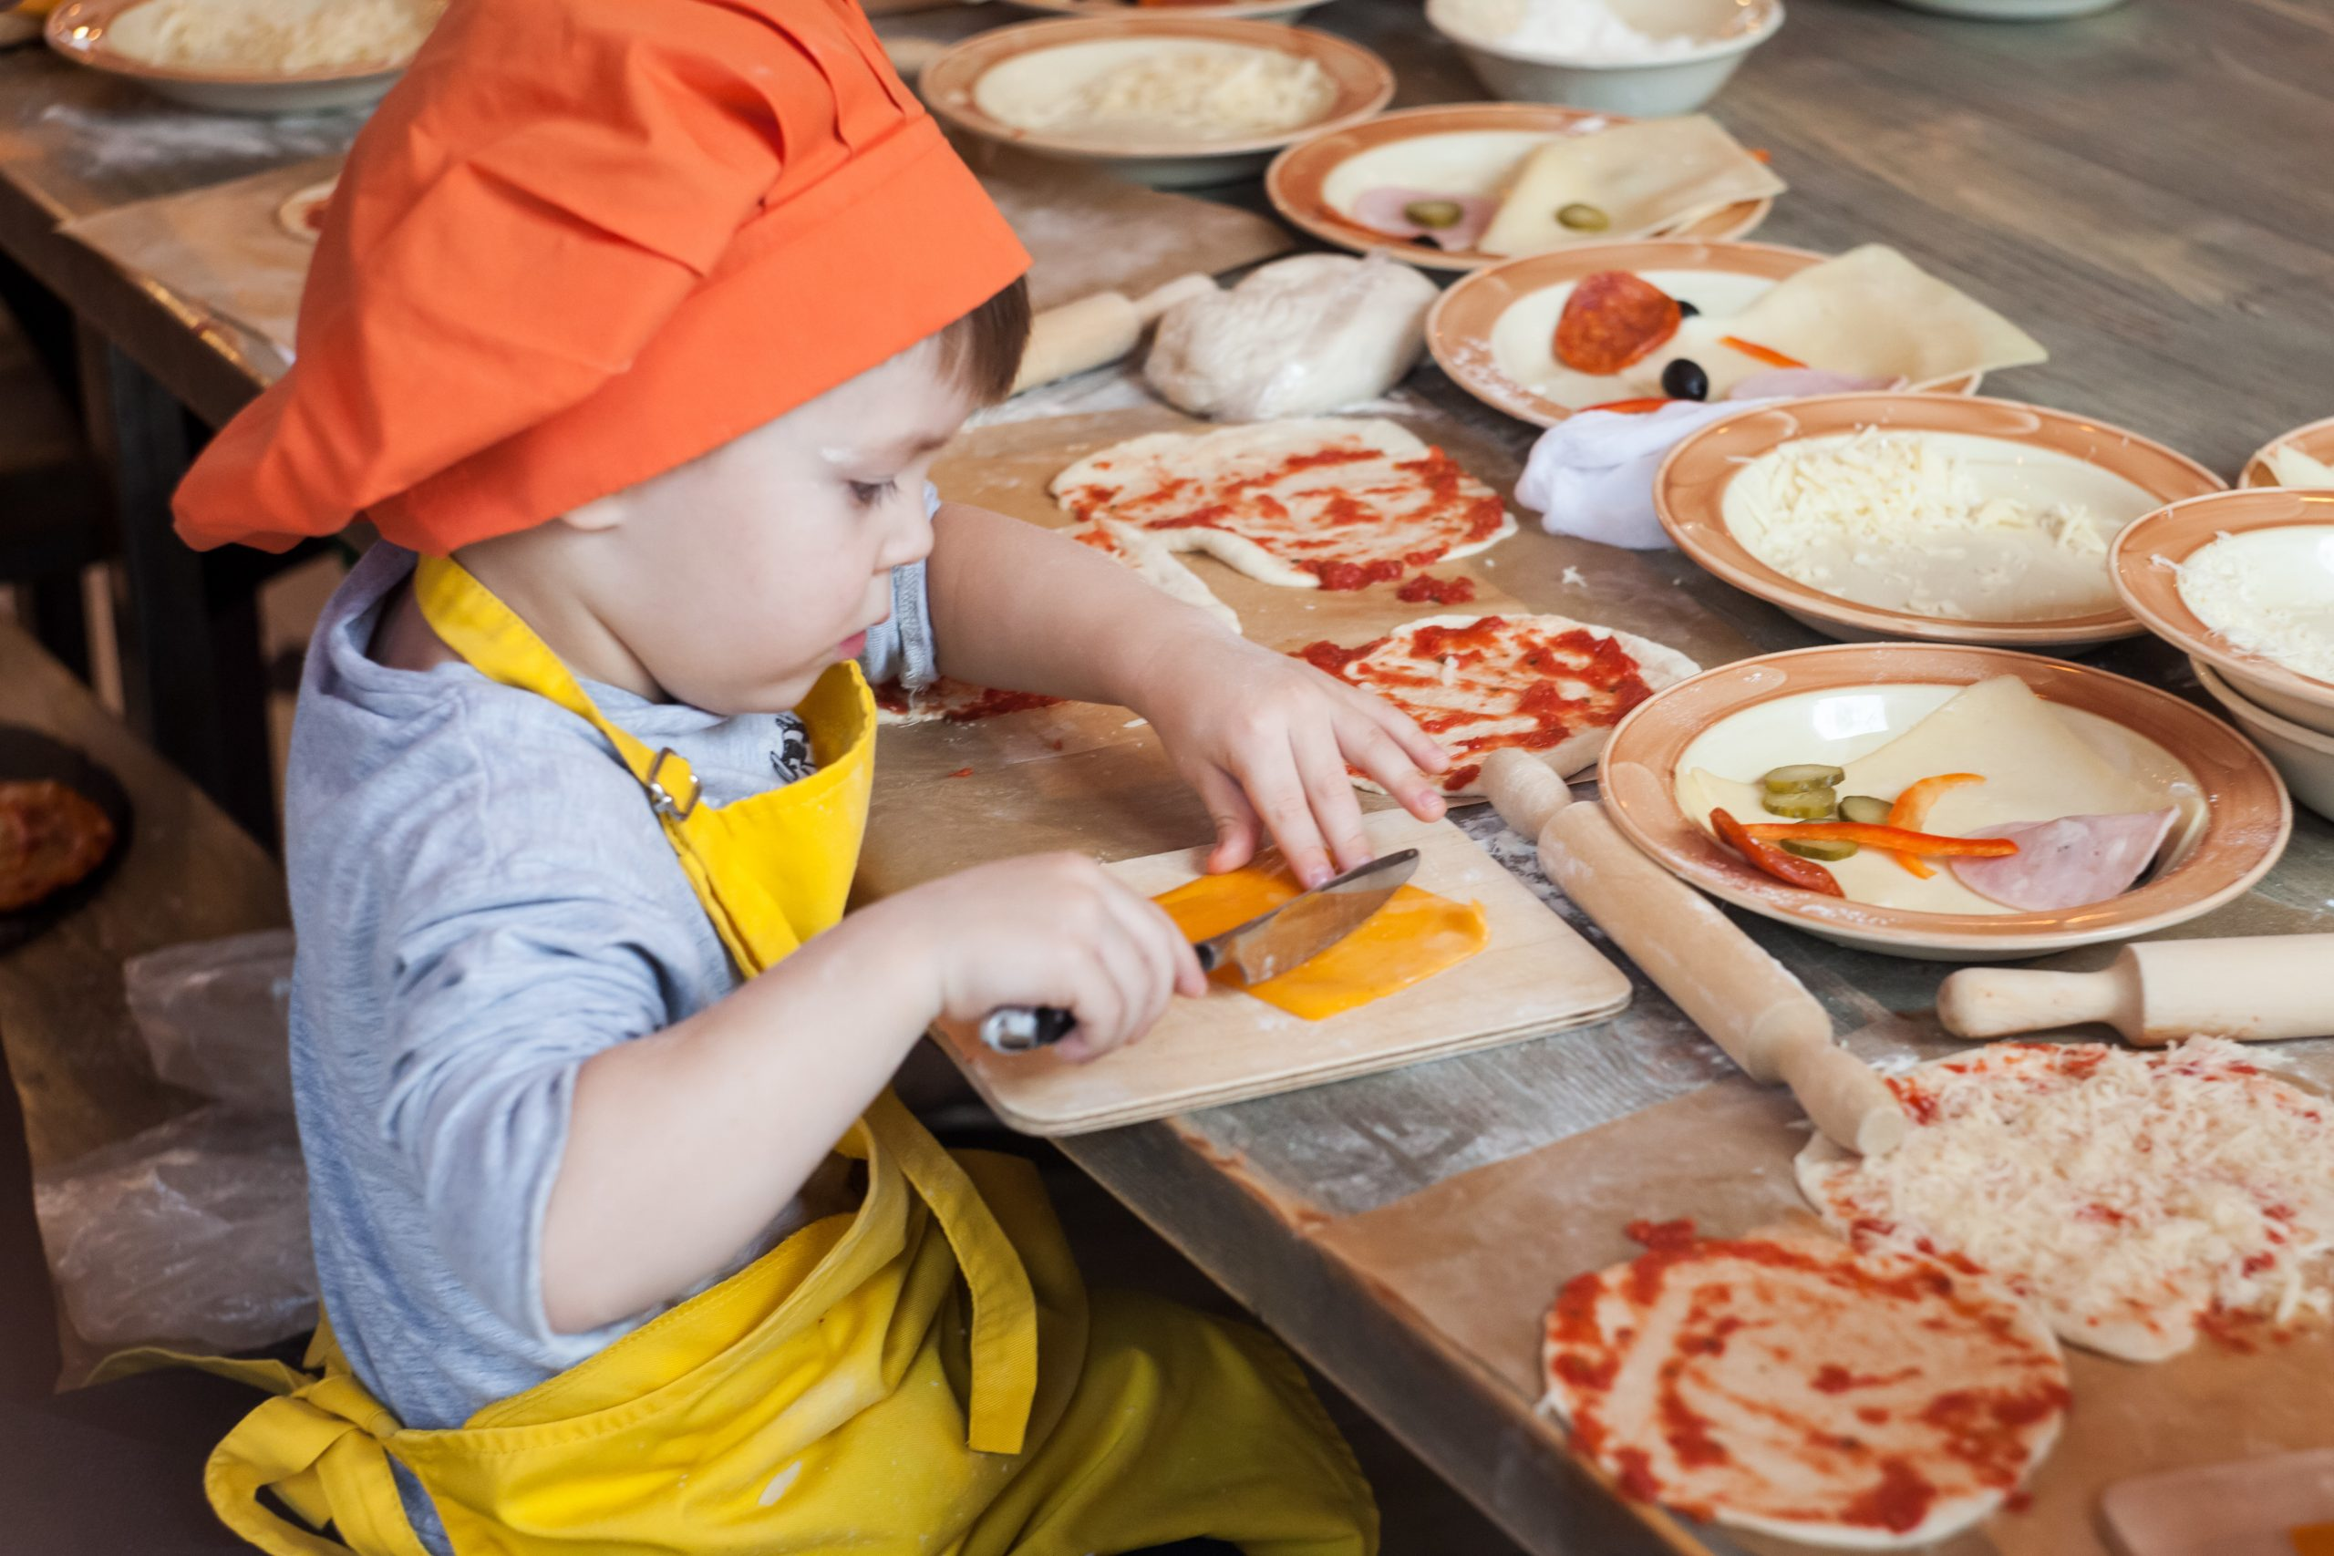
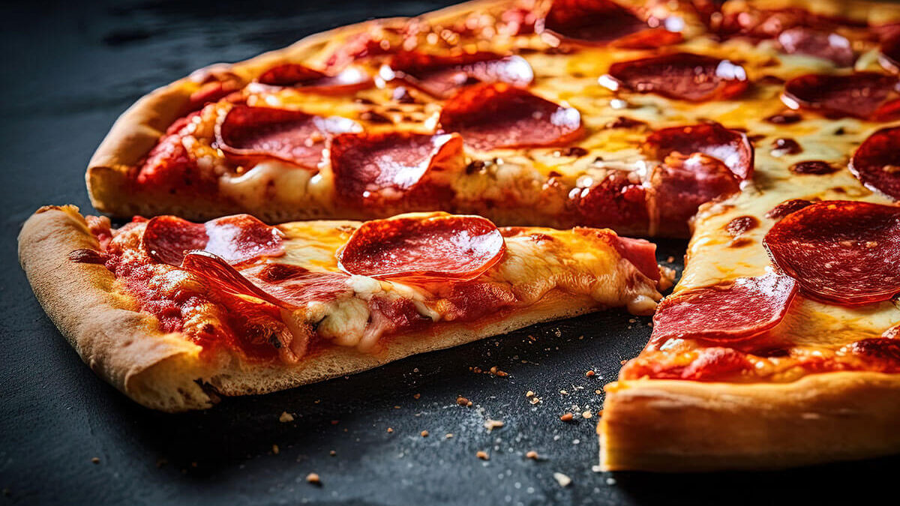
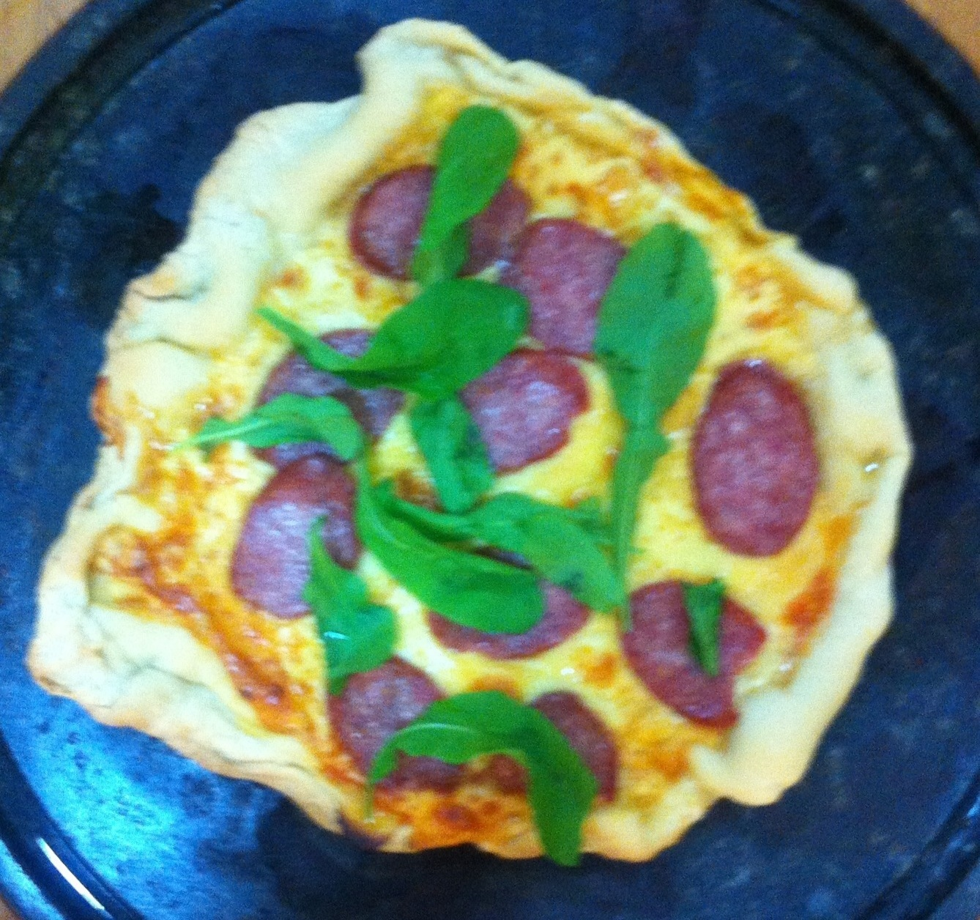
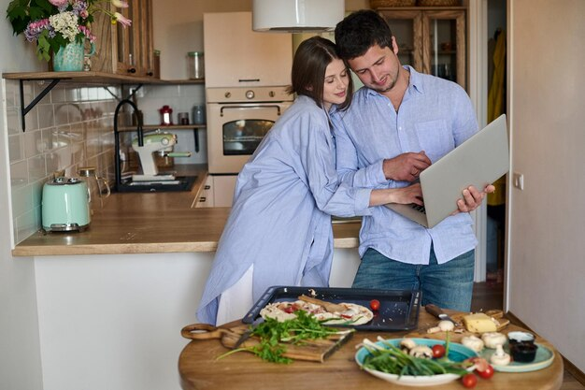
"How much do you like this food?"
Likert Item...
Strongly dislike
Dislike
Neutral
Like
Like Strongly

Slide 7
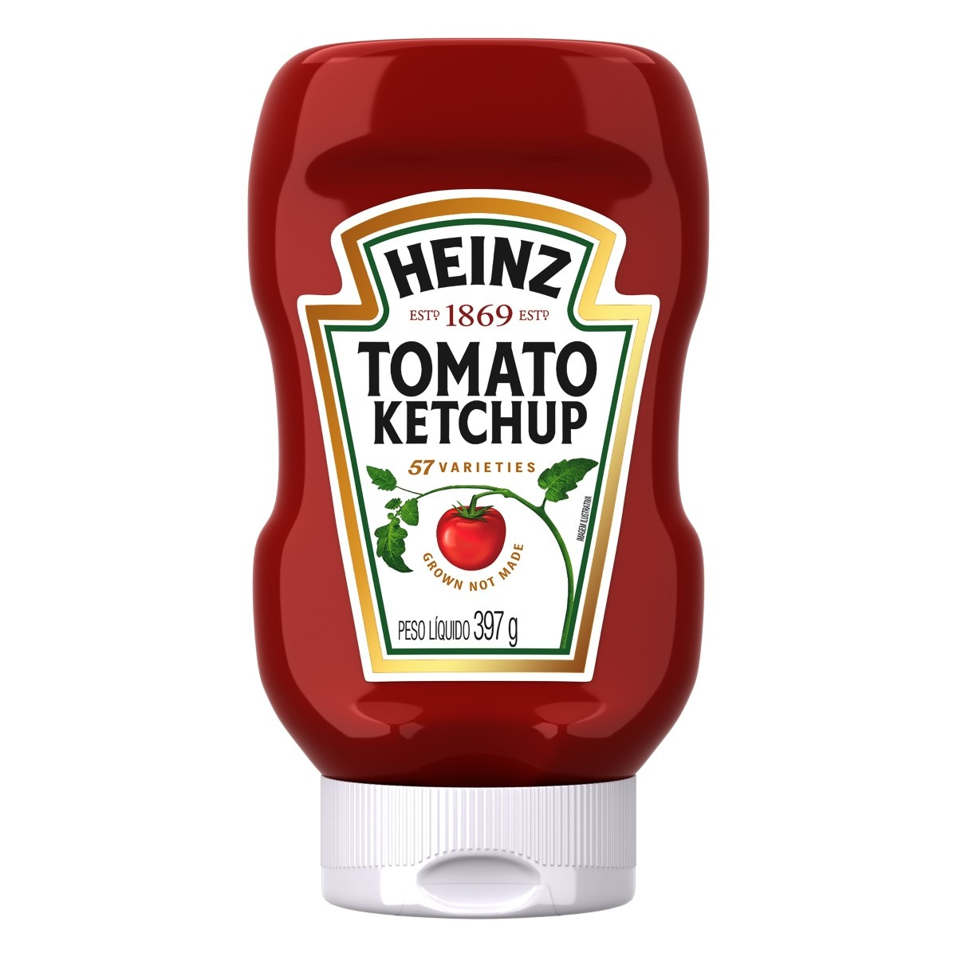
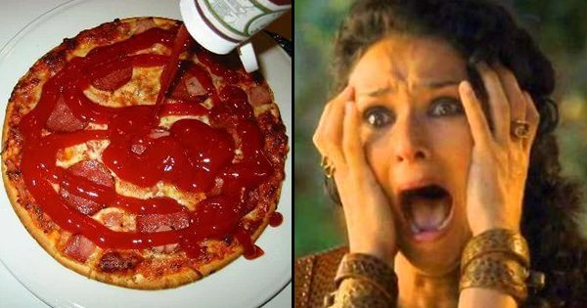
How to unscramble the genuine tomato sauce from the ketchup?

Slide 8
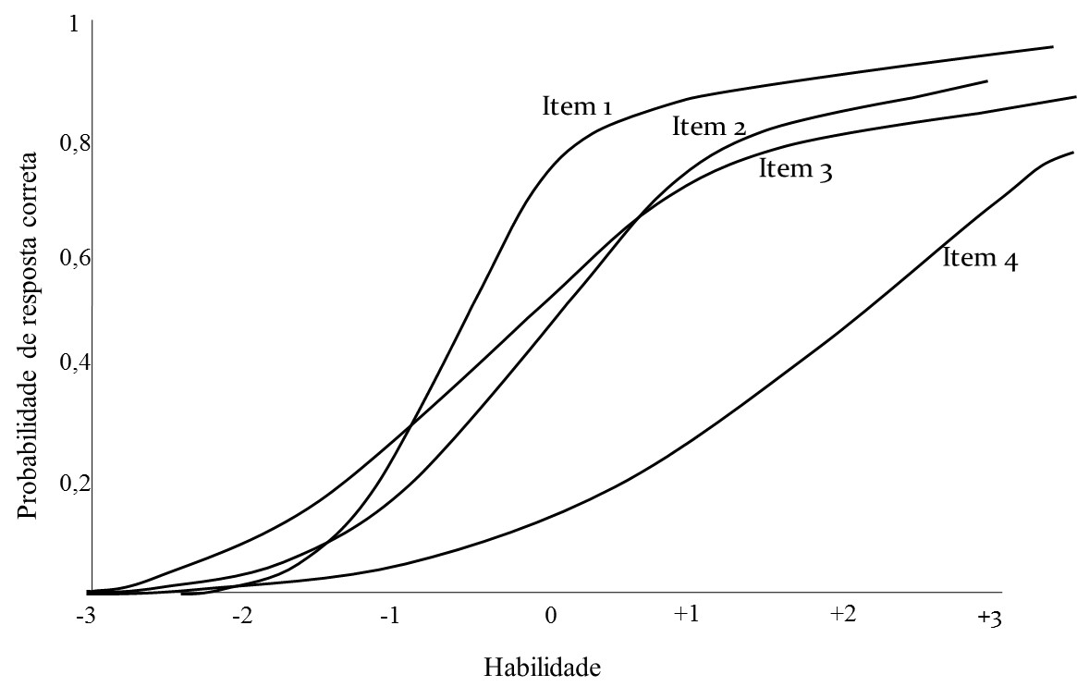
psychometric models postulate relationships between the 'functioning' of items, the psychological attribute of the individual, and the observed score on a specific item.
U_{ij} = μ_{j} + λ _{j} η _{i} + ε _{i}
i = person
j = item
Item parameters are equal for all person?

Slide 9
U_{ijg} = μ_{jg} + λ _{jg} η _{ig} + ε _{ig}
DIF
i = person
j = item
g = group
1
P
μ_{jg and} λ _{jg}
are still heterogeneous due only a between subjects variable
0
-∞
0
+∞
θ

Slide 10
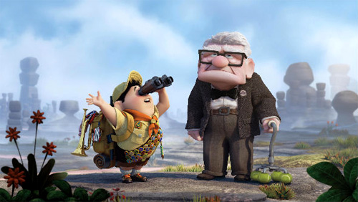
When the source of the variability is in the same level of the subjects ...
Do you like:
Pets?
Being outside?
Being inside?
Imagine Mr. Fredricksen answering...

Slide 11
When the source of the variability is in the same level of the subjects ...
bias
u1
u2
u3
η

Slide 12
Intra-person heterogeneity
Response biases are systematic and interpersonal distortions of the 'true responses’.
Personal-DIF
It is not necessarily an attempt at falsification.
It introduces an extra dimension into the model.

Slide 13
Responses might be affected by
Intrapersonal Thresholds Differences / group reference
Acquiescence
Extreme Response
Social Desirability
Overclaiming
Prestige ?
Among others…

Slide 14
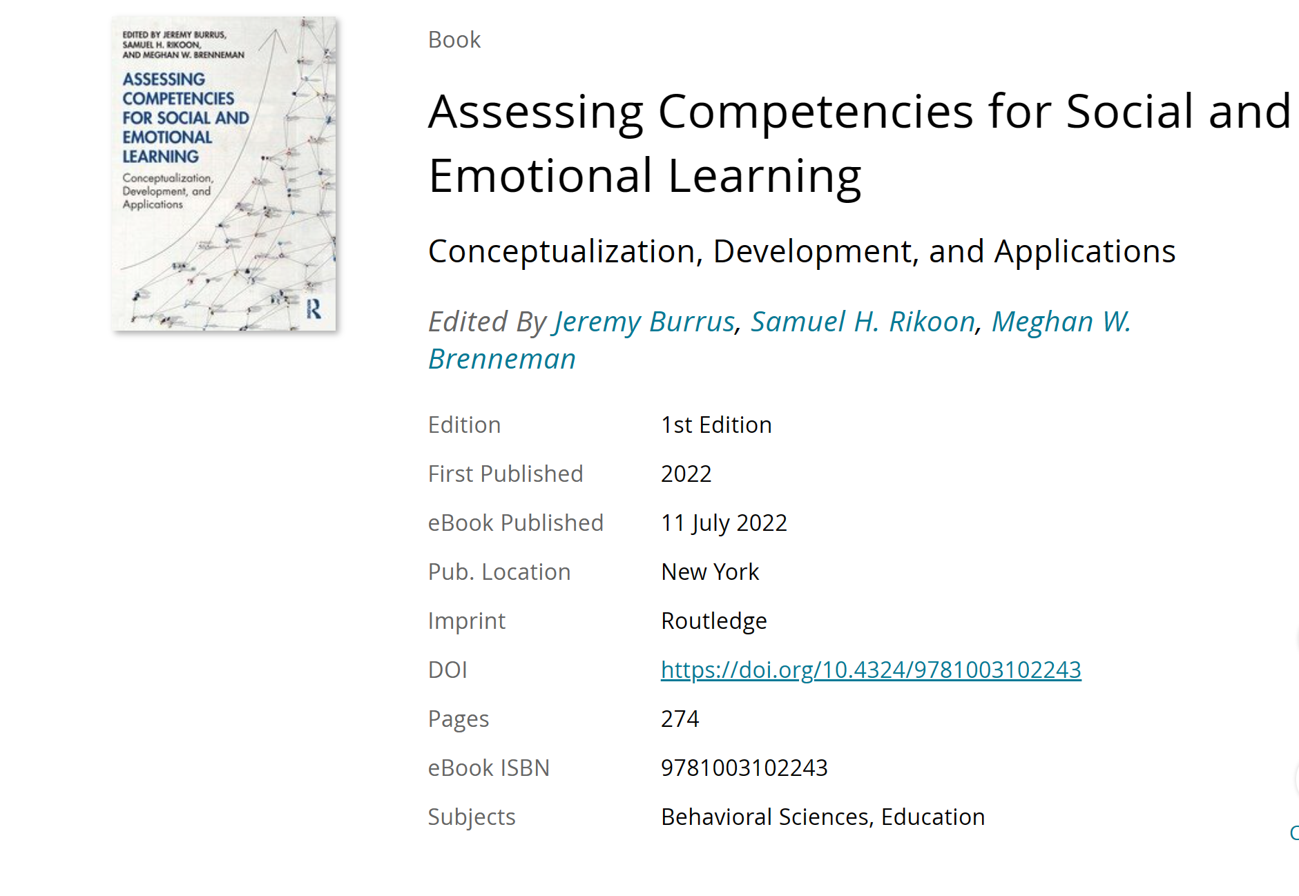
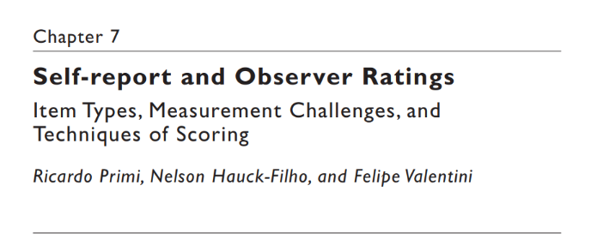

Slide 15
Bias | Definition
Acquiescence | Tendency to agree regardless of content of the question
Extreme Response | Unbalanced tendency to use the extreme ends of a Likert scale
Group Reference | Use of relative anchor points from a local group to make comparisons and position yourself to the local group benchmark.
Careless responding | Lacking sufficient cognitive effort when responding to the questionnaire
Social Desirability | Tendency to select answers that will cause a favorable impression
Overclaiming | Tendency on making exaggerated claims about the own knowledge, skills and competences

Slide 16
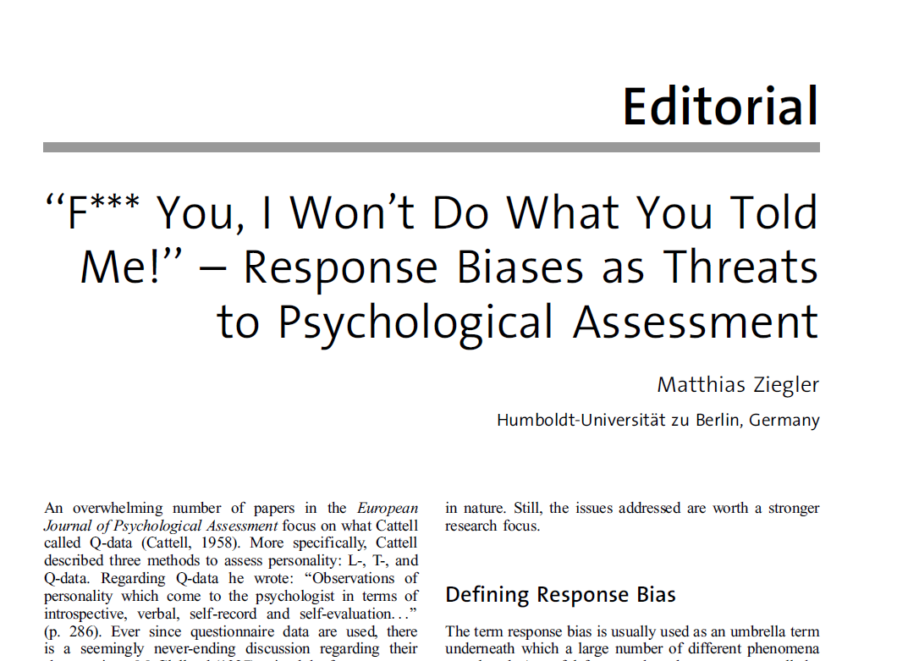
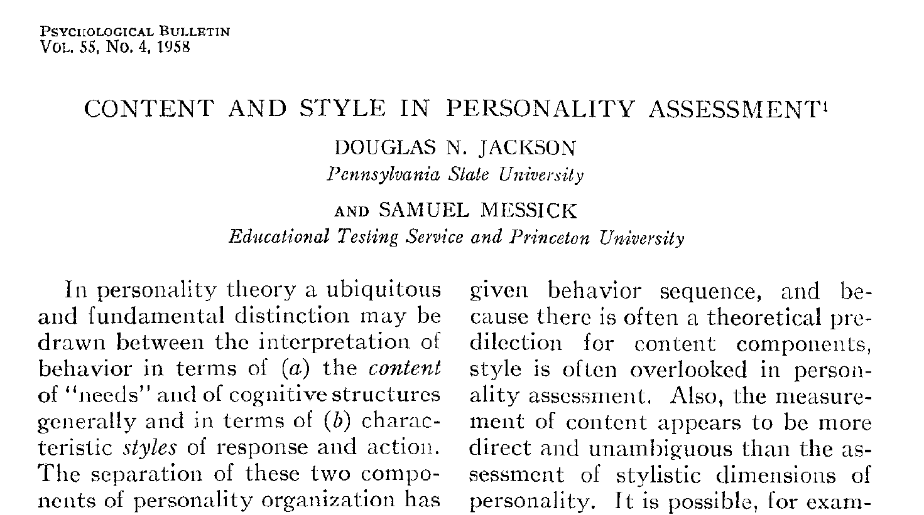
Response Styles (distortions across all questionnaires and situations)
Acquiescence
Extreme Response
Group reference or intrapersonal thresholds difference
Response Sets (temporary response due to a specific situation)
Social Desirability
Faking
Overclaiming
European Journal of Psychological Assessment, 2015

Slide 17
When does the bias occur?
response processes
First, the respondent reads the item statement and tries to understand the statement content (Encoding).
Second, the item content triggers the retrieval of relevant information from the long-term memory (Retrieval).
Third, the item content and the evoked information are compared to achieve a coherent judgment (Judgment).
Fourth, the individual selects the response option that best represents the judgment from the previous step (Response selection).
A fifth step (Editing) will also occur under some circumstances

Slide 18
When does the bias occur?
response processes
First, the respondent reads the item statement and tries to understand the statement content (Encoding). Insufficient effort responding
Second, the item content triggers the retrieval of relevant information from the long-term memory (Retrieval).
Third, the item content and the evoked information are compared to achieve a coherent judgment (Judgment). Social desirability, overclaiming (lead individuals to conclude that they are more skilled or morally virtuous than reasonably supported by their past behavior
Fourth, the individual selects the response option that best represents the judgment from the previous step (Response selection). Acquiescence
A fifth step (Editing) will also occur under some circumstances. Faking (social desirability, overclaiming)

Slide 19
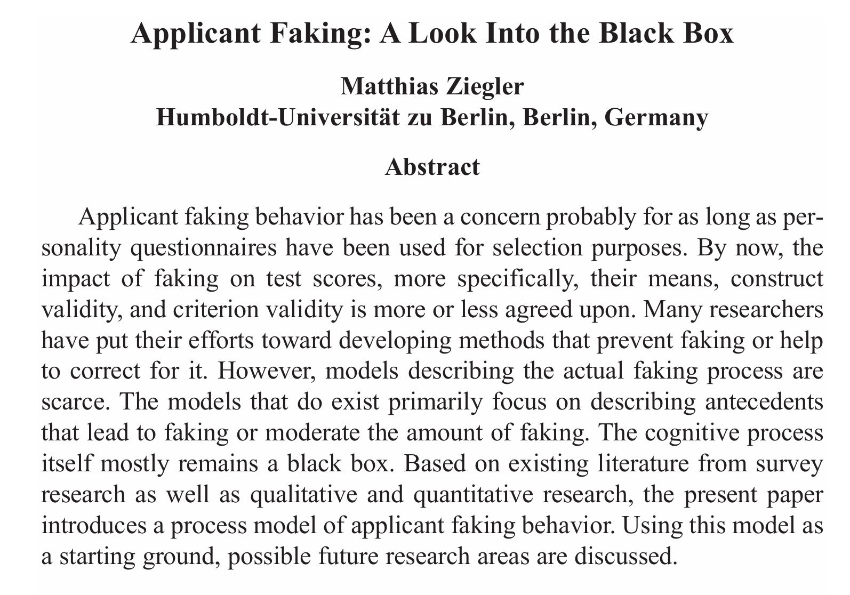
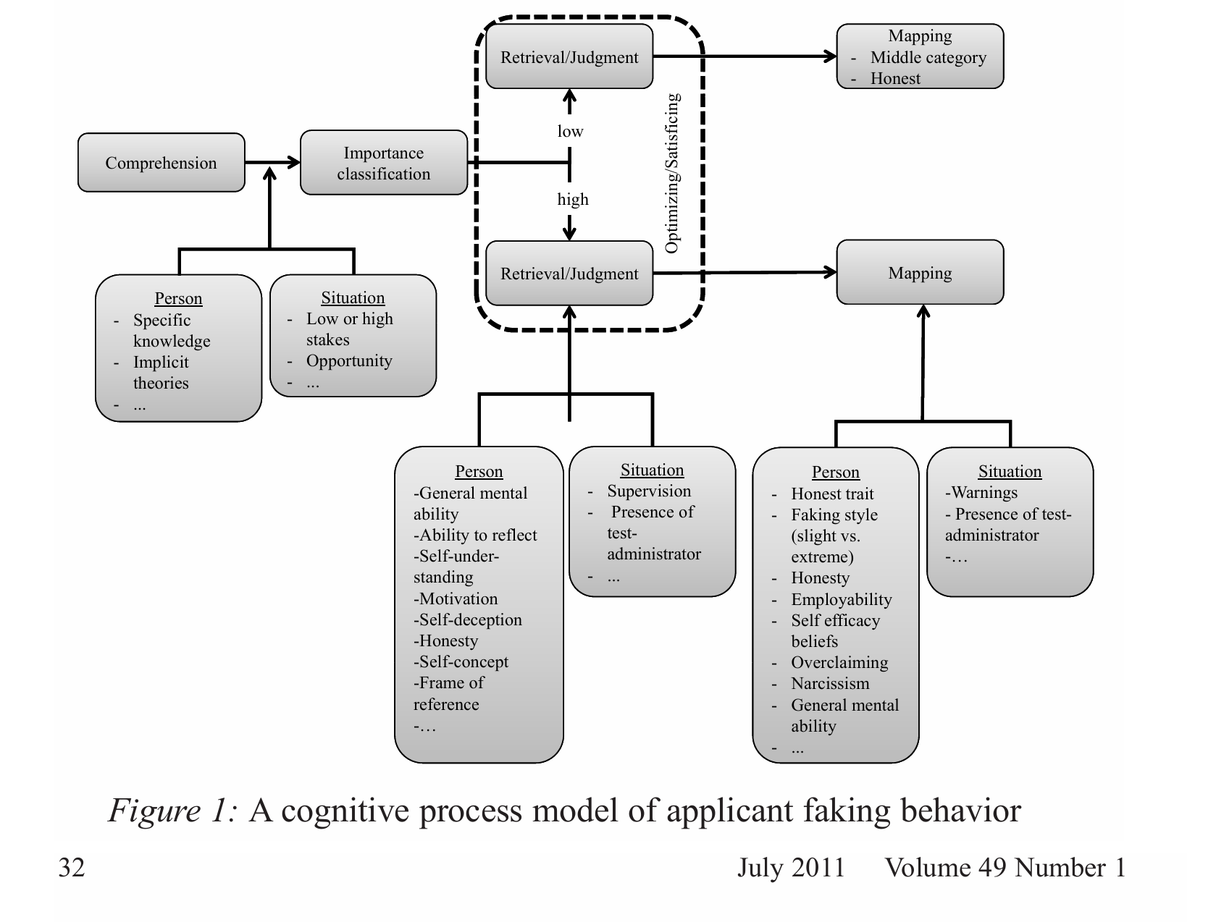

Slide 20
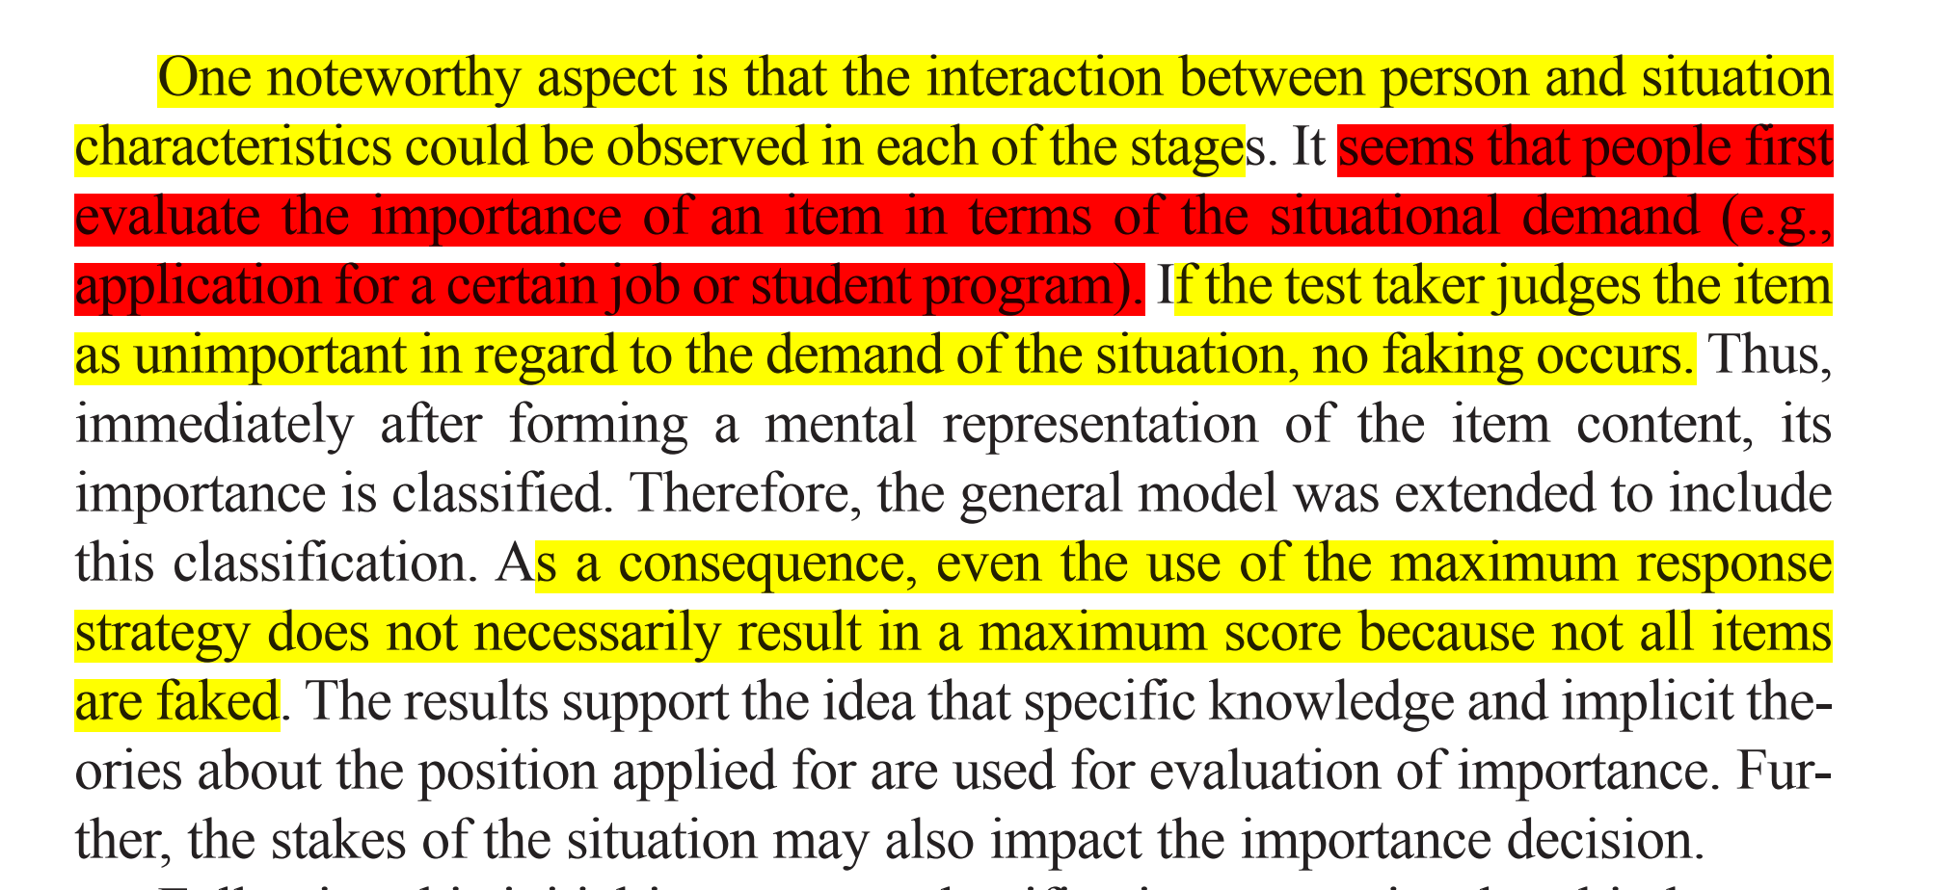
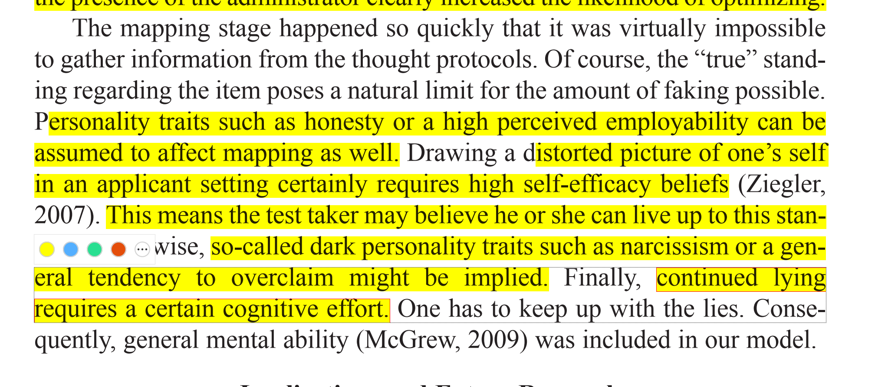

Slide 21
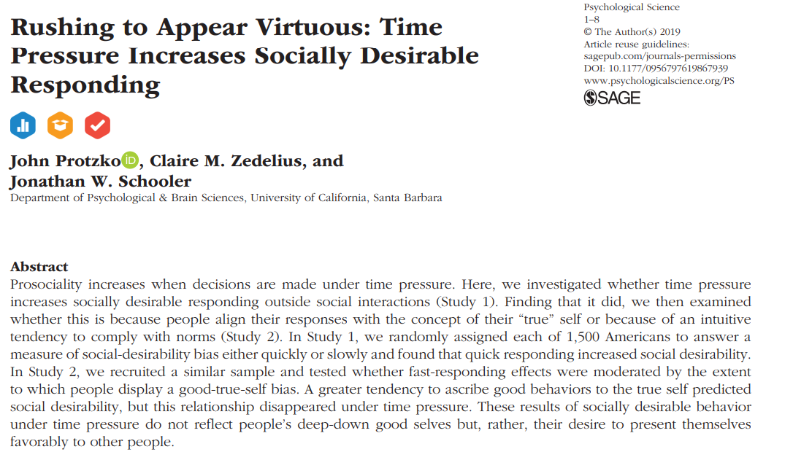
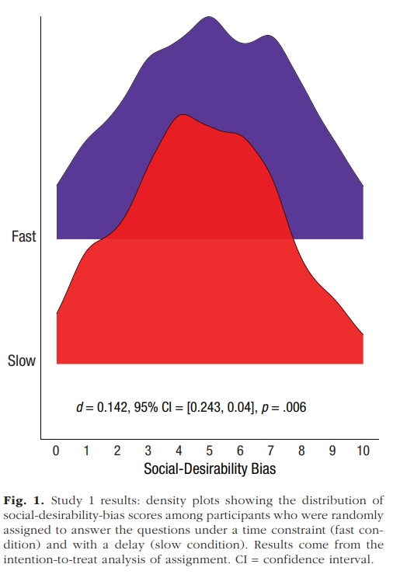

Slide 22
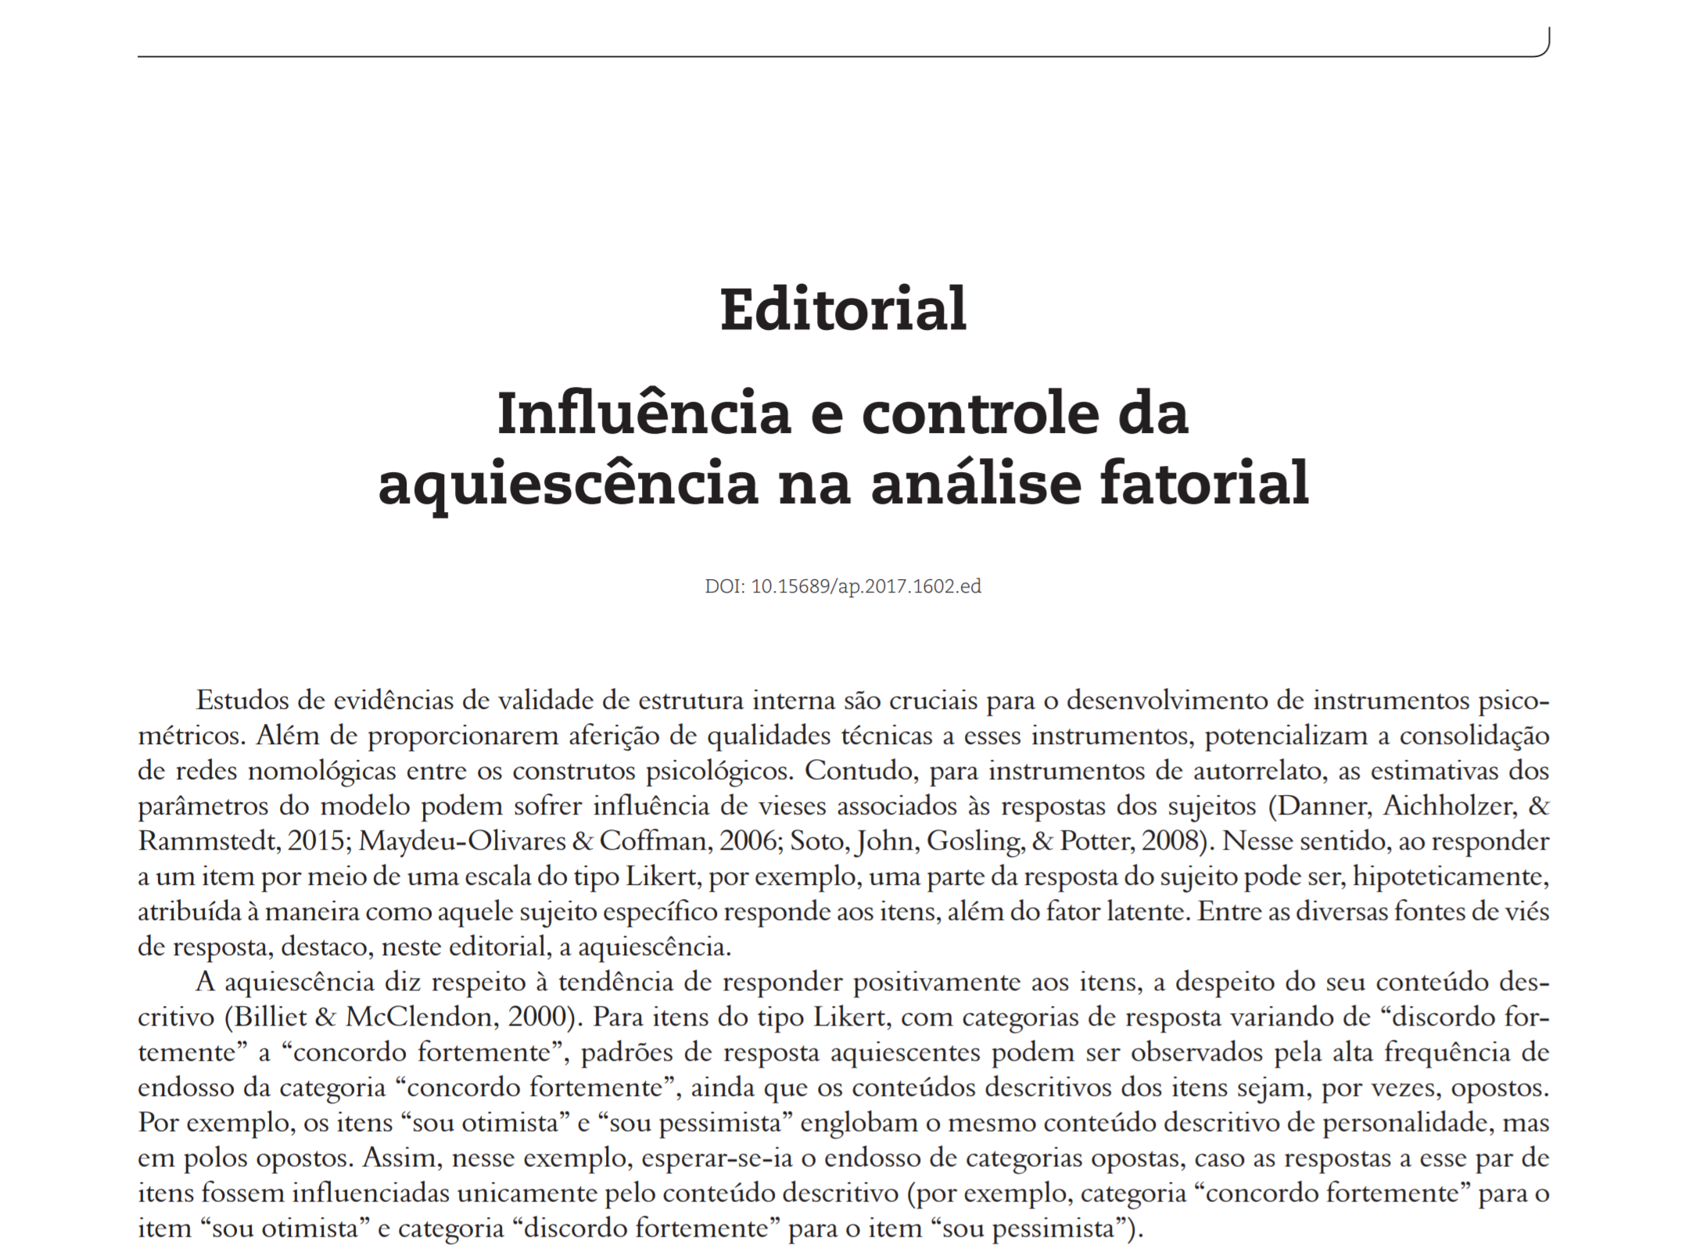
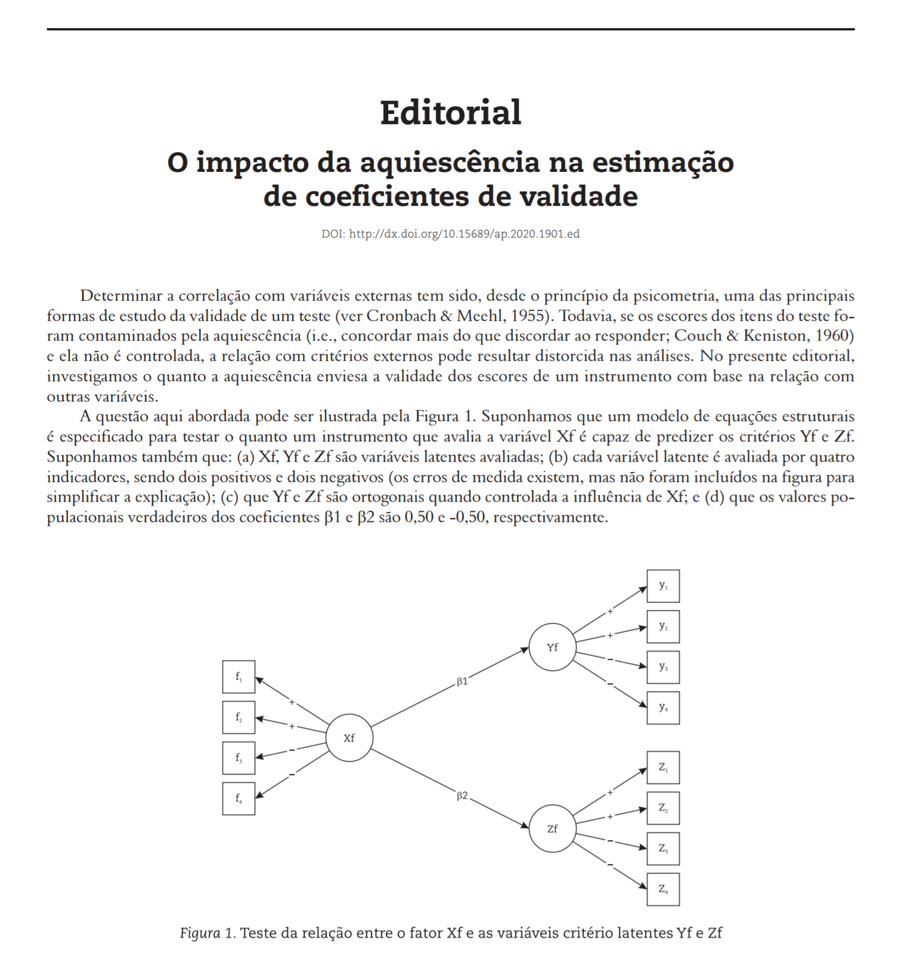
Why does it matter?
Impact on factor analysis...
Overestimation of a general factor
For unidimensional models, tendency to separate items into 'positive factor' and 'negative factor’
Overall mess in factor loadings
Failure in any factor retention decision method (parallel, hull, EGA etc.)
It also impact the correlations with external variables

Slide 23
Why does it matter?

Slide 24
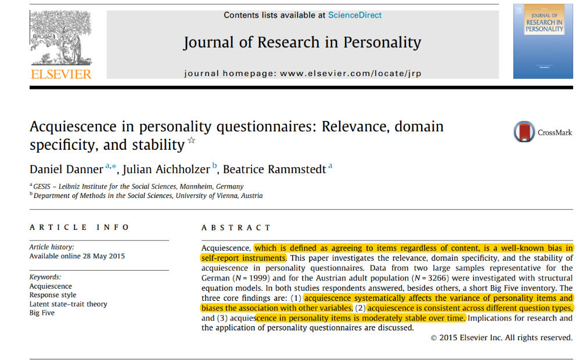

Slide 25
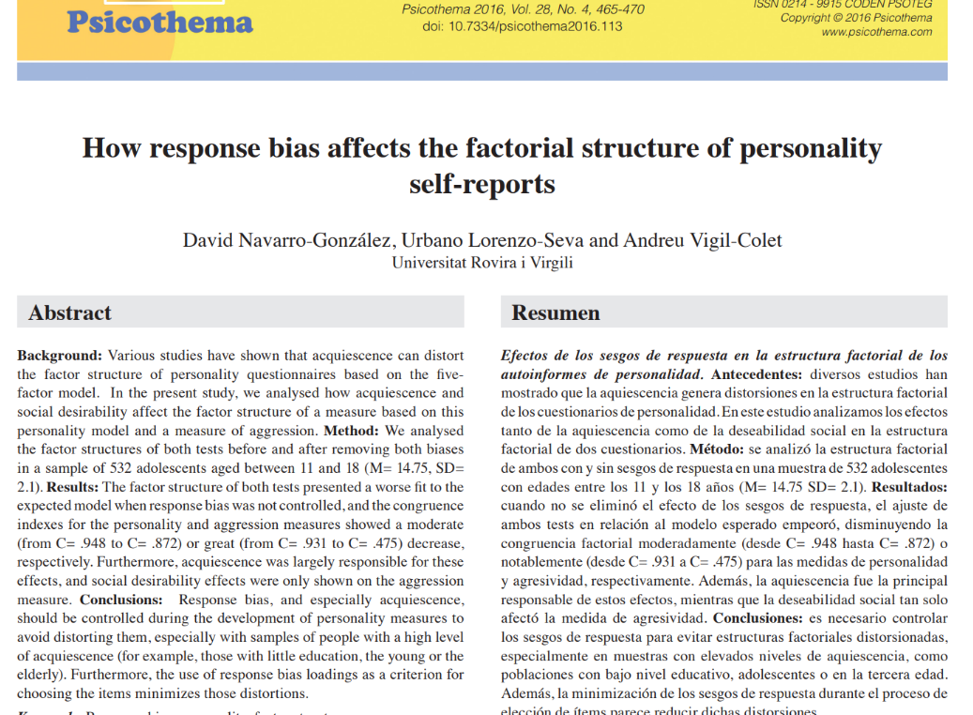

Slide 26
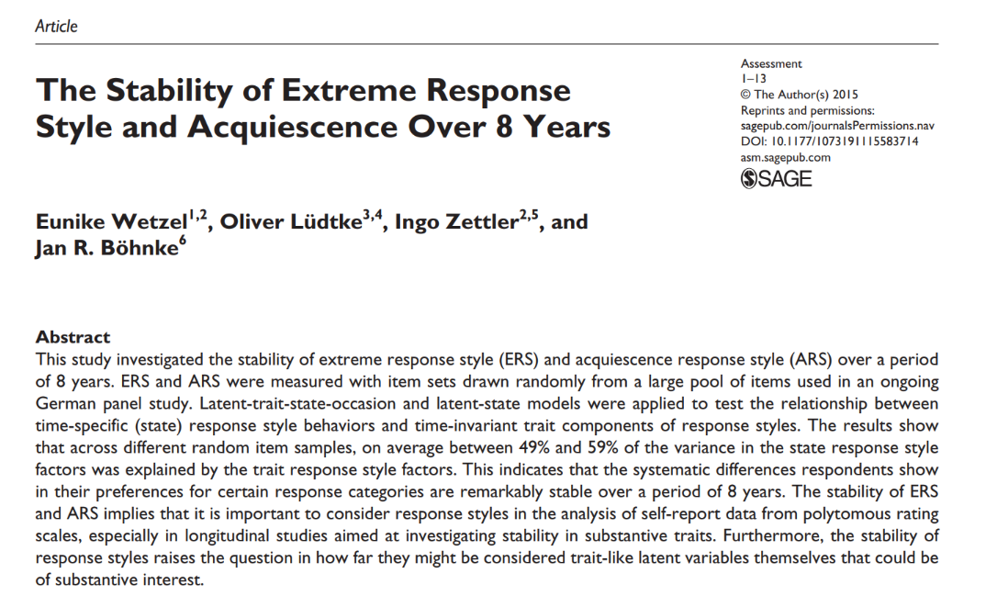

Slide 27
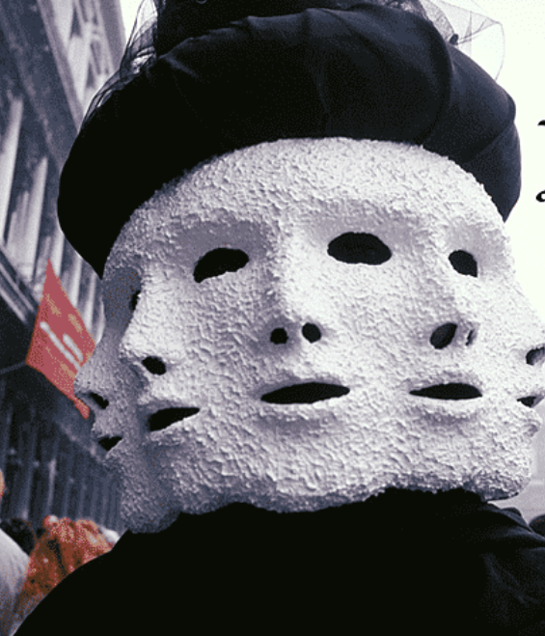
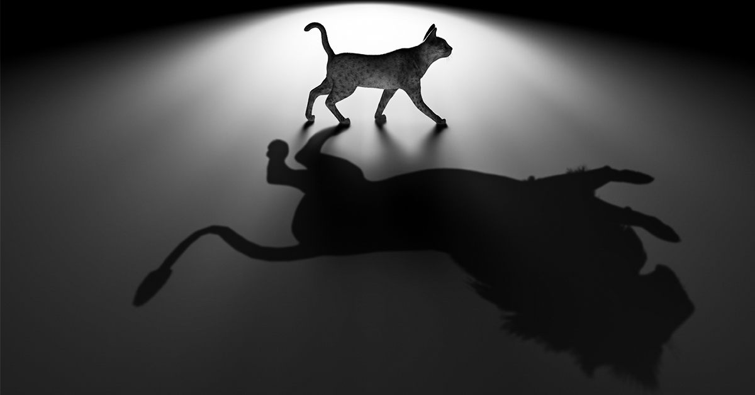
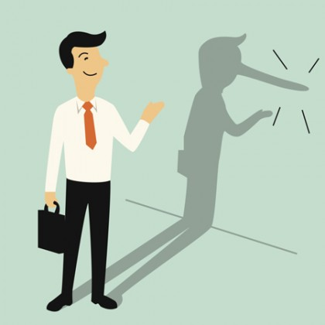
Lie ?
Self-deception
Situational
Wording
It is not true that I have never had difficulties solving complex mathematical questions

Slide 28



